Slide 1



How Crime Has Changed in St. Louis, MO
A study of how crime has changed from 2021 to 2023
December 2024
DATA SCIENCE SQUAD

Slide 2


Agenda
Introduction – Why analyze crime trends?
Meet the Team
Project Overview & Goals
Research Questions
Data Collection & Cleanup
Research Approach
Findings & Analysis
Conclusion & Insights
Q&A

Slide 3
Introduction
Why Analyze Crime Trends in St. Louis?
St. Louis has one of the highest crime rates in the U.S., making this analysis both relevant and critical.
Understanding crime trends helps improve public safety, allocate resources effectively, and support data-driven policy-making.

Slide 4







Meet the Team
Leslie
Bland
Luther Johnson
Cameron
Keplinger
Eshumael Manhanzva
Valarie
Miller
Saurabh
Singh
Tyler
Shubert
Teaching Assistant
Your Role

Slide 5
Project Overview & Goals
Overview:
We analyzed crime data from the St. Louis Metropolitan Police Department for the years 2021, 2022, and 2023.
Analyzing only the Top 5 crimes.
The purpose of our analysis was to identify trends and patterns in crime rates across three key dimensions:
Time of Day
Month-to-Month Changes
Seasonal Variations
Goals:
Understand Temporal Patterns:
Identify how crime activity fluctuates during different times of the day.
Detect Month-to-Month Trends:
Determine how crime rates shift across the months within each year.
Assess Seasonal Effects:
Examine how crime rates are influenced by seasonal changes over the three-year period.

Slide 6
Research Questions
Have crime rates increased or decreased between 2021 and 2023?
Do crime patterns vary across the seasons?
How have trends for different crime types evolved?
Which times of year exhibit the highest and lowest crime rates?
What time of day experiences the least crime?

Slide 7

Data Collection & Clean Up
St. Louis Metropolitan Police Department crime data
CSV was downloaded from: https://slmpd.org/stats/slmpd-downloadable-crime-files/?dpage=1
We focused on data fields reflecting the types of crimes, times of day crimes were committed, monthly rates of crimes, seasonal rates of crimes, and yearly data values.
CSV file has 18138 total records covering 2021-2023

Slide 8
Data Collection & Clean Up
Data Cleanup Overview
Determined the Visual Studio data dependencies to review the Top 5 Crime types.
Property Damage : 1st Degree
Property Damage : 1st Degree (Motor Vehicle)
Stealing : Motor Vehicle
Stealing
Leaving Scene of Accident (Motor Vehicle)
Dropped irrelevant columns and crime types.
Converted column to proper date/time format.
Dropped null/missing values from data

Slide 9

Research Approach
We used a descriptive analysis method:
Summarizing raw data, providing basic insights like averages, counts, and trends, answering "what happened" questions.
Assumptions:
Most crimes occur at night
Seasonality may have an impact on crime
Assaults and homicides are likely among the Top 5 crime types

Slide 10
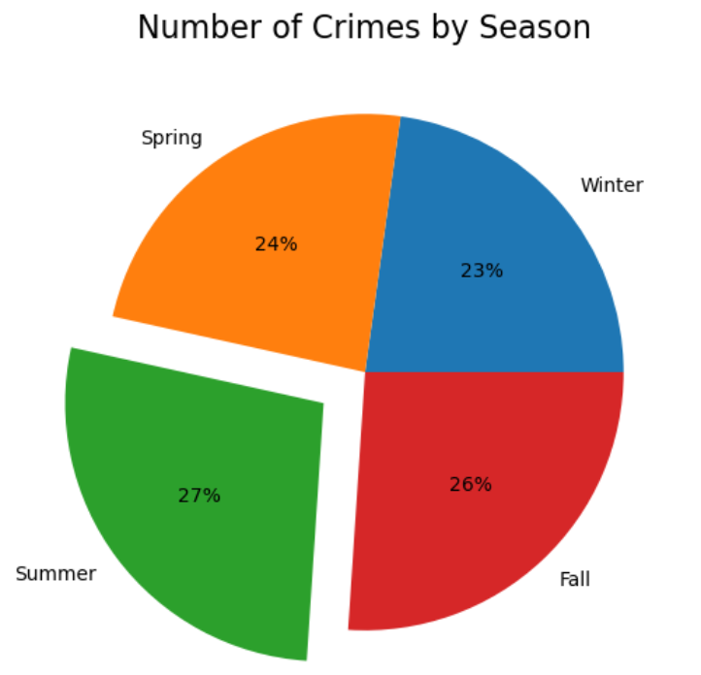
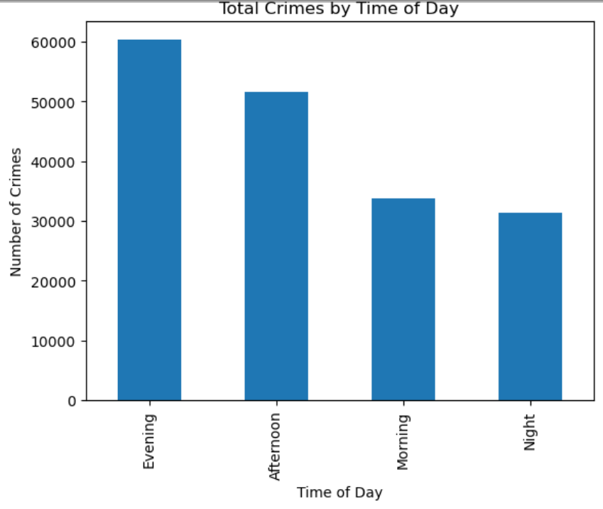
Finding and Analysis

Slide 11
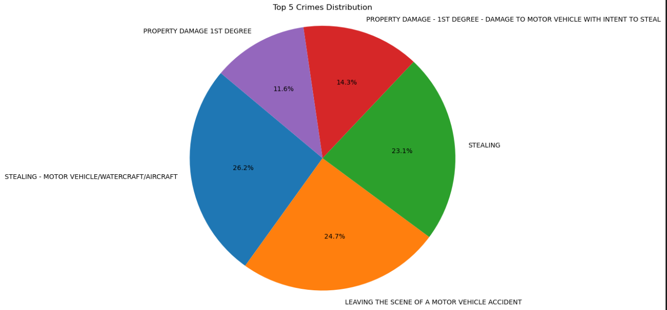
Finding and Analysis

Slide 12
Conclusion & Actionable Insights
Of the 3 years studied, the most crimes studied were committed in 2022
Of the 3 years studied, the most crimes were committed in the summer
July 2021 and 2022 had the most crime, but January had the most crime in 2023
Of the 5 crime types studied, evenings have the most instances (6pm - 9pm)
Of the 5 crime types studied the fewest crimes were committed at night
Car thefts are the most common of the crimes studied
Of the 5 crime types studied,winter months have the fewest incidents.
Property damage (1st Degree) occur less than the other crimes studied.
Increase patrols during summer evenings.
Focus on theft prevention strategies in peak months.
Optimize resources during winter.

Slide 13

Questions & Answers

